Slide 1
🌐
OFFLINE LANGUAGE DETECTOR
A machine learning system for detecting English, Hindi & Japanese text — trained on Google Colab, deployed as a native desktop app with Tkinter
Rudresh Mishra
B.Tech, 3rd Year — United College of Engineering and Research, Allahabad

Slide 2
INTRODUCTION
Why an Offline Language Detector?
1
No Internet Dependency
Detects the language of a sentence instantly without calling any cloud API — everything runs locally on the user's machine.
2
Privacy by Design
Text typed by the user never leaves the device, since there is no network call involved in the detection process.
3
Multilingual Input Support
Built to recognize three scripts with very different structures: English (Latin), Hindi (Devanagari) and Japanese (Kanji/Kana).
Offline Language Detector
2

Slide 3
OBJECTIVE
Project Goal
Build and deploy a lightweight language identification model that classifies typed text into English, Hindi, or Japanese — accurately, instantly, and completely offline.
Train
Package
Deploy
Build a text classification model in Python on Google Colab
Export the trained model for offline, local inference
Wrap it in a Tkinter desktop GUI for real-time use
Offline Language Detector
3

Slide 4
TECH STACK
Tools & Technologies
Python
Core programming language for data processing, model building and the desktop app
Google Colab
Cloud notebook environment used to train the classification model with free GPU access
Tkinter
Python's built-in GUI toolkit used to build the native offline desktop interface
Scikit-learn / NLP Libraries
Feature extraction (n-grams / text vectorization) and model training for language classification
Offline Language Detector
4

Slide 5
METHODOLOGY
How the System Works
1
2
3
4
5
Dataset
Preprocessing
Model Training
Export Model
Tkinter App
→
→
→
→
Text samples collected for English, Hindi & Japanese
Cleaning & feature extraction on Google Colab
Classifier trained to distinguish language patterns
Trained model saved for offline use
User types text → model predicts language + confidence
The model is trained once in the cloud (Colab), then runs entirely on the local machine through the Tkinter interface — no internet required at prediction time.
Offline Language Detector
5

Slide 6
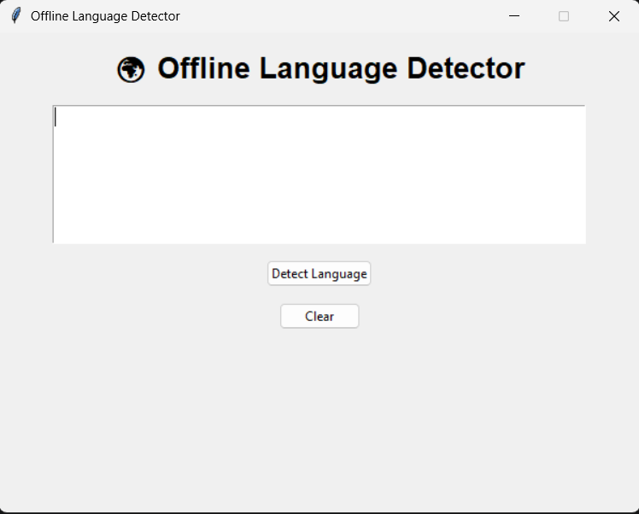
APPLICATION
The Desktop Interface
A clean Tkinter window lets the user type or paste any sentence into the text box.
Simple, distraction-free text box for input
"Detect Language" button triggers the offline model
"Clear" button resets the input instantly
Offline Language Detector
6

Slide 7
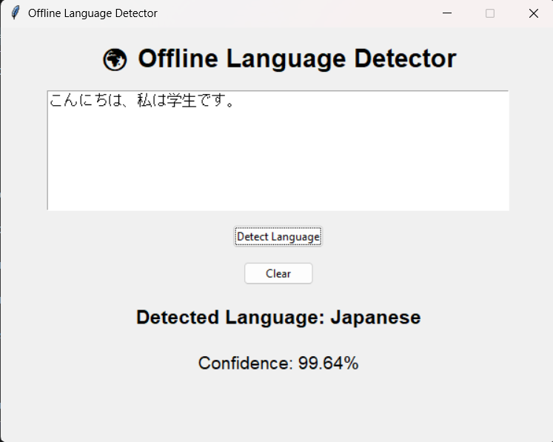
APPLICATION
Language Detected in Action
Example: a Japanese sentence is typed in, and the app instantly identifies the language with a confidence score.
Input: こんにちは、私は学生です。
Japanese
99.64%
Detected Language
Model Confidence
Offline Language Detector
7

Slide 8
COVERAGE
Supported Languages
English
Hindi
Japanese
Latin script
Devanagari script
Kanji / Kana script
Hello, I am a student.
नमस्ते, मैं एक छात्र हूँ।
こんにちは、私は学生です。
Sample recognized input
Sample recognized input
Sample recognized input
Offline Language Detector
8

Slide 9
RESULTS
Outcome & Performance
3
99.64%
0
Languages Supported
Sample Confidence Score
Internet Connections Needed
Key takeaways
The model reliably separates scripts with very different structures (Latin, Devanagari, Kanji/Kana)
Running fully offline makes the tool fast, private, and usable without any setup beyond installation
Tkinter proved sufficient for a clean, responsive desktop experience without extra frameworks
Offline Language Detector
9

Slide 10
FUTURE SCOPE
What's Next
1
Add More Languages
2
Sentence-level Analytics
Extend the classifier to support additional languages beyond English, Hindi and Japanese
Show per-word or per-phrase breakdowns for mixed-language text
3
Mobile Deployment
4
Speech Input
Package the offline model into a lightweight Android/iOS app
Add voice-to-text so spoken language can be detected too
Offline Language Detector
10

Slide 11
Thank You
Offline Language Detector — English · Hindi · Japanese
Rudresh Mishra
B.Tech, 3rd Year — United College of Engineering and Research, Allahabad

